Slide 1
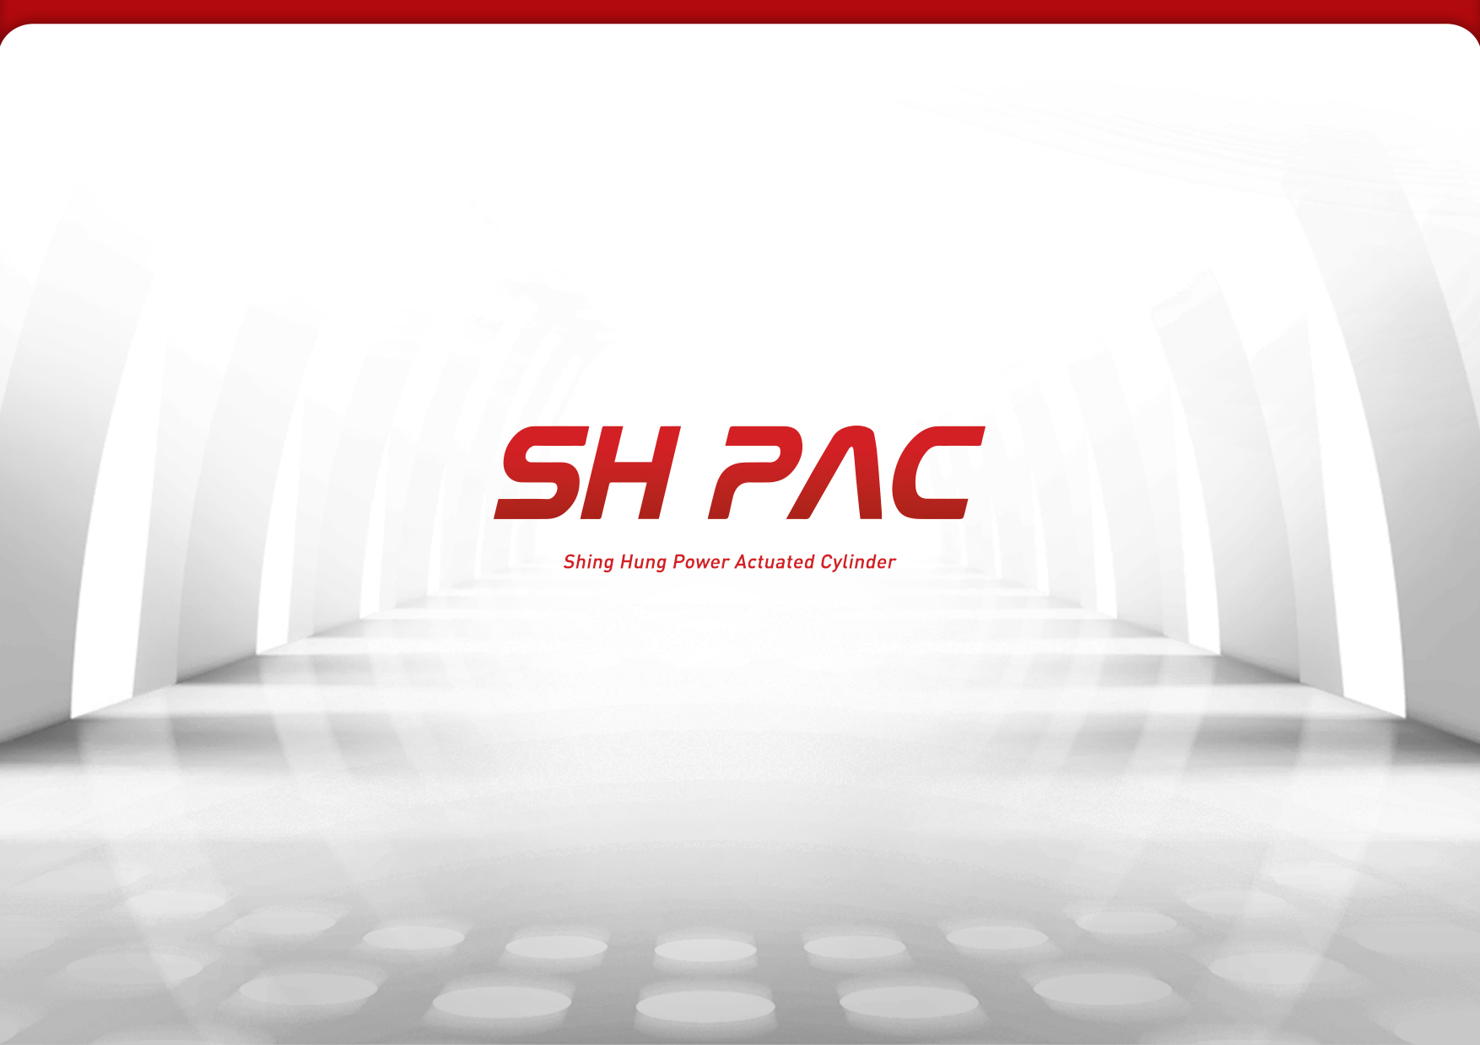

Slide 2
Contents
-
I.
II.
III.
IV.
V.
VI.
VII.
Company Profile
Introduction of SH PAC
Introduction of SH PM
Global Network
Sales Item
Working Experience with Customers
R&D Status
Vision of SH PAC

Slide 3
SH PAC Profile
Business of the Rod
(43years)
Foundation
Introduction
Growth
Maturing
Stability
Growth
Stability
Business of the cylinder (25years)
Introduction
Explore
Growth
Maturing
Stability
1970’s
1980’s
1990’s
2000’s
2010’s
’73
’76
’78
Establishment
· Shin Hung Hard Chromium Plating Industry Co
Supplier registered for KASCO(The matrix of the current KIA)
· PISTON ROD for two wheeled vehicle
Re-named Shin Hung Precision Machinery --- · Established consistent production system
Machining
→grinding
→plating
· start-up the production of two wheeled vehicle
’80
’85
’87
’88
Localized Production of Automible Parts
· developed 20 kinds of parts including Brake piston
Established mass production system
(400K/month)
· Approved with the systematization automobile parts business from KIA
Introduced TQC
· Nominated as a small and medium enterprise practicing modernization(‘86)
· Produced the Cyld Rod for forklift & heavy machinery
· Selected as a leading company of technology
Acquired 1st grade as the quality management of factory.
· Won grand prize as an outstanding cooperative company of KIA
’90
’93
’95
’97
Began manufacturing our own hydraulic cylinders
· selected as a promising leading technology enterprise
· Began manufacturing hydraulic cylinder of Special car
· Moved our manufacturing facility to 3rd JANG-LIM (‘91)
Changed corporation of Shinhung precision machinery
Separated department
· ROD business : Janglim
· Cyld business : Gimhae
Acquired ISO certification (ISO9001)
· Selected as promising export company
· Selected as outstanding CMHA cooperative company
’00
’06
’07
’09
Designated Bset supplier from VOLVO
· Moved to Noksan and Expanded plant
· ISO 9001,14001
· Production capacity Increased
(15,000pcs/Month)
Divided Corp of Cylinder department
Establishment of SH PAC
Established Laboratory
Established SH PAC USA
· Certification of Cylinder’s Manufacturing Technical from HITACHI
’11
’13
’14
’15
Increased production capacity
(25,000pcs/Month)
· Expanded and Moved to Hwajeon
· confirmed cylinder manufacturing technology by CAT
30milion dollars export award
50million dollars export award
Established SH PAC JAPAN
Won grand prize of Busan Industry management
Acquired AEO ceriification as overall outstanding enterprise

Slide 4
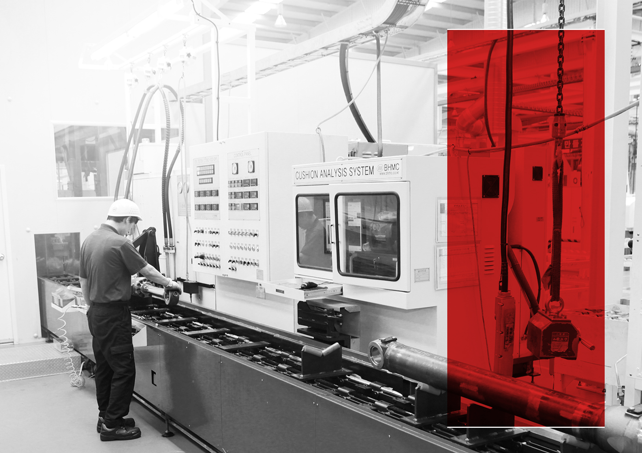
“
Ⅰ
. SH PAC
Production of Best Quality based on Technical enhancement
- SH PAC Summary
- SH PAC Sales Condition
- Items Segmentation
- Capacity
”

Slide 5


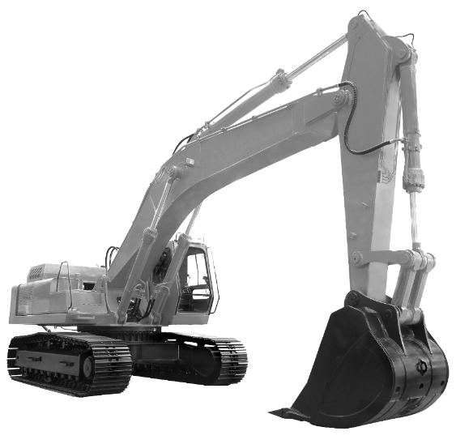

Ⅰ
.
Company summary and Condition of Sales/Production
Belief for Customer, Continually Development
SH PAC
화전산업단지
248,700ft²(23,100㎡)
Lot Area
Capacity
25,000pcs/month(1 shift )
209,304ft²(19,445㎡)
Plant
Product
Hydraulic cylinders for construction equipment
Approx. 207
Employee
Production Line
9 lines
SH PAC Production
SH PAC Sales
[PCS/year]
[USD mil./year]
CAPA_1shift
3%
7%
10%
10%
8%
11%
1,300
1,400
380K
28%
1,260
12%
360K
370K
1,033
40%
41%
268K
`10
`12
`14
`16
`18
`10
`12
`14
`16
`18

Slide 6



Ⅰ
.
Production Segmentation
Safe Profit and Export Expansion through Market Segmentation
By Application
By Customer
100%
Other
100%
ALTEC
KOMATSU/
HITACHI OTHERS
Forklift
OSHKOSH/JLG
AWP
GENIE
CAT
60%
60%
Construction
CLARK
HYUNDAI
20%
20%
VOLVO
`08
`10
`12
`14
`16
`18
`08
`10
`12
`14
`16
`18
By Exporting/Domestic
Comment
100%
1. Heavy duty construction equipment market secured
2. SH PAC market share is getting increased.
3. Strategic partnership with customers
4. Diversification of customer/market
- Management of Foreign currency risk
- Flexibility of market fluctuation
5. Increased Exports
Other
60%
Export
20%
Domestic
`08
`10
`12
`14
`16
`18

Slide 7
Ⅰ
.
Capacity
The Largest Scale and Singular Plant in Korea
Product specification
ITEM | TUBE ID | LENGTH | REMARK
ASSEMBLY | Φ40~Φ400 (1.5” ~ 15”) | ~12,000mm (up to 472”) | 636bar (9135psi)
Capacity of “CYLINDER” [month]
Process | CYLINDER | TESTING | PAINTING
 | ASSEMBLY
 | Monthly
Hours(h) | 8 | 10 | 8
Shift | 1 | 1 | 1
Capacity(pcs) | 30,000 | 25,000 | 28,000
Actual(AVG.) | 16,000 | 16,000 | 16,000
Rate(%) | 53 | 64 | 57
Number of Equipment | 8 | 8 | 4
Total Capacity of “CYLINDER”
Section | Hours | Shift | Max Capacity | Current Capacity | Rate
ASSEMBLY | N/A | 1 | 300,000(pcs) | 192,000(pcs) | 64%

Slide 8
Heavy duty construction equipment market secured
Increased Exports
SH PAC market share is increased
Flexibility of market fluctuation through the diversification of customer/market
Securing Market Competitiveness based on Technical enhancement ,
Strategic partnership with customers
Infinite power of SH PAC

Slide 9
“
Ⅱ
. SHPM
SHPM Always Striving for Best Products
- SHPM Summary
- SHPM Sales condition
- Items Segmentation
- Capacity Status
”

Slide 10

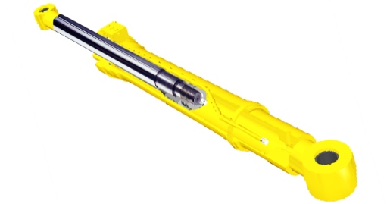
Ⅱ.
Company summary and Condition of Sales/Production
Best Plating Technology for 45 years, Enhancement of Global Competition
SHPM
화전산업단지
장림동
138,000ft²(12,800㎡)
Lot Area
Capacity
50,000pcs/month(1shift )
116,267ft²(10,800㎡)
Plant
00
Product
Hard chromed Rods
96
Employee
cutting - manufacture = grinding - plating
SHPM Production
SHPM Sales
[PCS/year]
[USD mil./year]
CAPA_1shift
17%
2%
10%
19%
45%
3%
519K
8%
433K
2%
17%
52%
353K
361K
320
384
273
267
`10
`12
`14
`16
`18
`10
`12
`14
`16
`18

Slide 11



Ⅱ.
Production Segmentation
Safe Profit and Export Expansion through Market Segmentation
By Application
By Customer
100%
Forklift
100%
SH PAC
AWP
60%
60%
HYUNDAI
Construction
VOLVO
20%
20%
`08
`10
`12
`14
`16
`18
`08
`10
`12
`14
`16
`18
By Exporting/Domestic
Comment
100%
Export
1. Trend change : Major class from 20 to 30tons
Domestic
2. ROD Global market is increasing
60%
3. Environmental plating equipment improvement
20%
4. Replacement surface treatment technology
`08
`10
`12
`14
`16
`18

Slide 12
Ⅱ.
Capacity
Best Plating Technical for 45 years
Product specification
ITEM | ROD OUT DIAMETER | ROD LENGTH | REMARK
Machining | Φ25~150mm(1”~6”) | ~10,000mm (up to 393”) | -
Plating
Product Capacity
Process | Cutting | Machining | Polishing | Plating | Overall
 | Monthly |  |  |  | Annual
Hour(h) | 8 | 8 | 8 | 10 | N/A
Shift | 1 | 1 | 1 | 1 | 1
Max Capacity(pcs) | 60,000 |  |  | 50,000 | 600,000
Current Capacity(AVG.) | 35,000 |  |  | 35,000 | 420,000
Rate(%) | 58 |  |  | 70 | 70
Number of Equipment | 4set | 53set | 22set | 7line | -

Slide 13
“
Ⅲ
. Global Network
SHPAC
– Global leading enterprise
by expanding global network
- SUPPLY CHAIN
- Customer
”

Slide 14















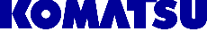












Ⅲ.
SUPPLY CHAIN
GLOBAL JIT & VMI Realization
SEATTLE
Chambersburg
BELGIUM
CHINA
JAPAN
UK
OKLAHOMA
Savanah
EUROPE
CHINA
KOREA
JAPAN
N.A
Germany
Seattle WA
Belgium
St. Joseph MO
Creedmoor SC
United Kingdom
Pooler GA
Guelph CANADA
Chambersburg PA

Slide 15


Ⅲ.
SUPPLY CHAIN
GLOBAL JIT & VMI Realization
EU
CHINA
JAPAN
USA
Future Network
In EU
SH PAC CHINA
since 2013
SH PAC JAPAN
since 2014
SH PAC USA
since 2009
Estimation In 2016
LOCATION
LOCATION
LOCATION
TIANJIN
TOKYO
Chambersburg, PA
Seattle, WA
Houston, TX
Strategic Alliance Partnership with India and China
Plan advance to the World and Expanding Export Business!

Slide 16
“
Ⅳ
. Product
Future of Korea is SH PAC !
Main Products and Working Experience
Construction Cylinder
Forklift Cylinder
Aerial work Cylinder
Special vehicle Cylinder
Mining Equip Cylinder
Rotary Actuator
”
Ⅴ
. Working Experience

Slide 17
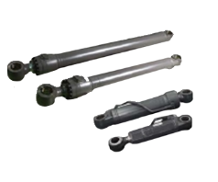
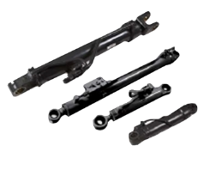
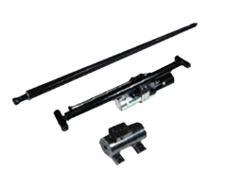
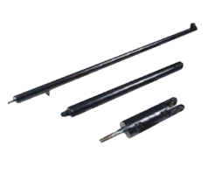
Ⅳ.
Products
Introduction of products
Current Main Products
Excavator (2.5t~120t class)
Wheel loader(2.5t~45t class)
Aerial work platform (2.5t~45t class)
Forklift (1t~25t class)

Slide 18
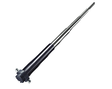
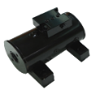
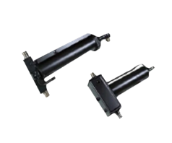
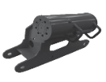
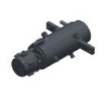


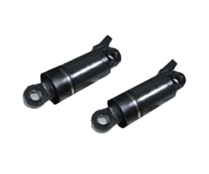

Ⅳ.
Products
Introduction of products
Current Main Products
Future Main Products
Dump truck
(2.5t~24t class)
Excavator (2.5t~45t class)
Utility truck
(30t~40t class)
Aerial work platform (1t~25t class)

Slide 19


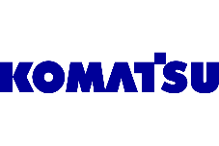




Ⅴ.
Working Experience
Working Experience with Customers
Construction Equipment
Machine
5,8,14,21,24,70ton Excavators
(Boom, Arm,Bucket, Blade)
Machine
Machine
Machine
3,5,8,11,14,21,30,
52,120tonExcavators
750/850 wheelloader
(Boom, Arm, Bucket, Blade)
30/40ton ADT
Suspension cylinders
4,6,45,65,85ton excavators
(Boom, Arm, Bucket, Blade)
Years
30
Years
30
Years
10
Years
6
Machine
8ton excavators
(Boom, Arm, Bucket,
Blade, Swing)
Machine
7.5ton excavators
(Boom, Arm, Bucket,
Blade, Swing)
Machine
BACKHOE,SKID LOADER
Years
3
Years
2
Years
1

Slide 20








Ⅴ.
Working Experience
Working Experience with Customers
Aerial work platform
Machine
Machine
Machine
Machine
Aerial Work Platforms
Telehandlers
Boom lifts
Aerial Work Platforms
Telehandlers
Boom lifts
Aerial Work Platforms
Telehandlers
Boom lifts
Aerial Work Platforms
Telehandlers
Boom lifts
Years
10
Years
7
Years
2
Years
2
Aerial work platform
Forklift
Utility truck
Machine
Utility Truck
Machine
ALL Cylinders
Machine
Utility Trucks with Various Booms
Years
1
Years
30
Years
10

Slide 21

“
Ⅵ
. R&D
Through Constant R&D,
Verifying High Quality and Technical !
- R&D Certification
- R&D Patent Application
- R&D Direction Guidance
- R&D Field
- Tech Development of ECO Surface Treatment
- AEO Certification
”

Slide 22


Ⅵ.
R&D Certification
Certification of Cylinder through Continuous Improvement _ Certification Total 11
1
2
3
4
5
Best Supplier
Cylinder Manufacturing Technology
Cylinder Manufacturing Technology
Best Cooperator Selection
Chrome plating and Painting technology
(Quality, Delivery, price)
2000
2009
2010
2010
2011
Volvo
Hitachi Tierra
Hitachi Group
Altec
Caterpillar
6
7
8
9
10
11
Rotary Actuator
120t
extra-large excavator’s cylinder
Busan
Strategic industry
Certification of Leading Company
ISO9001 :2008
ISO14001
AEO excellence certification
2014
2009
2010
2010
2000
2016
Quality Management System
Environmental Management System
INOBIZ
Research Institute
Certification of Leading Company
Korea Customs Service

Slide 23
Ⅵ.
R&D Patent Application
Continuous Patent Application from Compensation System_ Patent total 14.
1.Patent Application
2.Patent Application
3. Patent Application
4.Patent
Application
Cushion oil
(Auto Oil replenished type)
10-13232556
Pipe assy fixing pipe clamp
10-1306684
Pipe assy fixing pipe clamp design
30-0722419
ROTARY ACTUATOR
10-1396127
2013.10.23
2013.09.04
2013.12.19
2014.05.12
5.
6.
7.
8.
9.
Altec
ROTARY ACTUATOR Manufacture Method
10-1396125
BY-PASS Single acting Cylinder
10-2011-131657
BASE CUSHION 및 CHECK Function Integration
10-2014-0186630
High Strength & Output ROTARY ACTUATOR
10-2014-0054794
BANJO TYPE
Hydraulic PIPE
10-2014-0186627
2015.05.12
2011.12.09
2014.12.23
2014.05.08
2014.12.23
10.
11.
12.
13.
14.
SRB TOOL
Manufacture Method
10-2014-0186629
SRB TOOL
10-2014-0186628
SRB TOOL Design
30-2014-0062556
Chrome Plating Solution
10-2014-0180066
Chrome Plating Solution
10-2014-0190536
2014.12.23
2014.12.23
2014.12.23
2014.12.26
2014.12.26

Slide 24

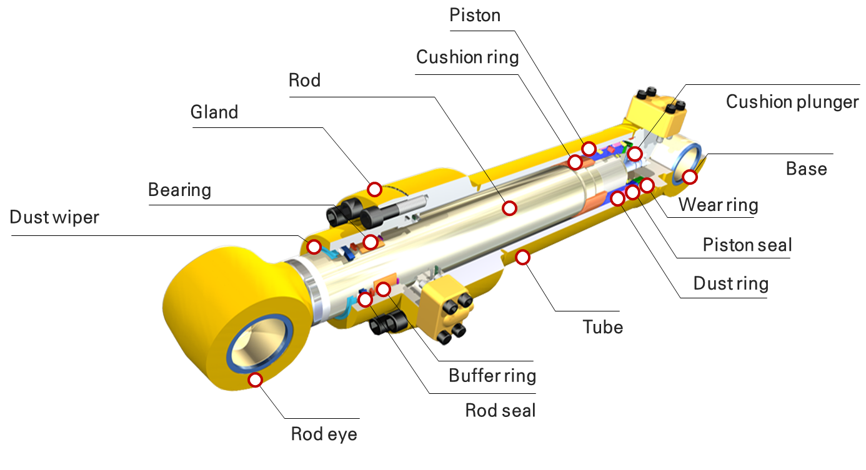
Ⅵ.
R&D Direction Guidance
3E Project
SH PAC Lab
Extreme (Severe) Condition
ECO
Friendly
Electronics
- smart
Sensor Tech
CYL Function
High-Corrosion Resistance
Rod
High-power
CYL Function
Weight reduction
Tube/Rod
ECO Surface Treatment
Rod

Slide 25














Ⅵ.
Company overview and Status of production & sales
History of SH PAC with Korea
AEO
(Authorized Economic Operator)
Safety and Belief for import and export over the world
*MRA signed nation (Standard 2015.12)
(2015.1.15)
China (2013)
Japan(2011)
Canada(2010)
Hong-Kong (2014)
U.S.A(2010)
Taiwan(2015)
Mexico(2014)
India (2015)
Singapore(2010)
Turkey (2014)
Israel (2015년)
Dominica (2015)
New-Zealand(2011)
Necessity and Benefits
Benefits by MRA
Management stability
Enhanced export competitiveness
Providing benefits such as omitting import tests, first check etc., while import clearance in countries adopted and carried out AEO program based on MRA
Easing financial burden through exemption of various duty investigation in principle and skipping collateral
Simplifying inspections & processes and providing diverse conveniences
Expecting synergy effect by benefits provided when import and export clearance in thirteen countries carried out AEO program(MRA)

Slide 26

“
Ⅶ
. SH PAC Vision
Suggestion SH PAC Vision for 2020
- 2015 ▶ 2020
”

Slide 27



Ⅶ.
Vision of SH PAC
Jump up to be a leading Company in the world !
AS-is
To-be
2015
2016
2017
2018
2019
2020
573PPM
Continuous Improvement
Zero PPM for 200
Competitiveness
Cost Reduction
Improve the productivity
BEST PRICE
US(3)·EU(2)·JP(3)
Global Supply Chain Global production (CHINA, INDIA)
Global Network
VMI for the all customers
Actions!
100%
Onsite production support
Management for customer oriented
ISO, AEO, Global management
Securing Competitiveness as AEO Company
·Efficient process, Quick decision, lean organization

Slide 28

Globalization of the products by consistent developing technology !
Korean Top-ranking company leads the New generation

